Slide 1

Online Exam Proctoring System
Zoom for Test
19102078 Inyeong Kang
19102085 Sehong Park
19102092 HyeonYeong Seo
19102095 Dohui Lee
Notes:
원래 우리팀은 줌과 같은 화상회의서비스에 대해서 프로젝트를 진행하려고 했다
하지만 그것에서 조금 새로운 기술을 더하여 온라인 시험 감독 시스템을 주제로 프로젝트를 진행하기로 변경하였다.

Slide 2
CONTENTS
System Description
Team’s Project Objectives
Cost/Benefit Analysis
01
02
Environmental Analysis
03
04
AHP Analysis
05
Conclusion
06

Slide 3
System Description
01

Slide 4





Service Description
01
Exam
Notes:
그래서 우리가 새롭게 선정한 기술은 온라인 시험 감독 시스템이다
해당 시스템이 온라인 화상 회의의 대표 주자인 줌의 화상 회의 서비스에서 확장 가능할 것이라고 판단하였따

Slide 5

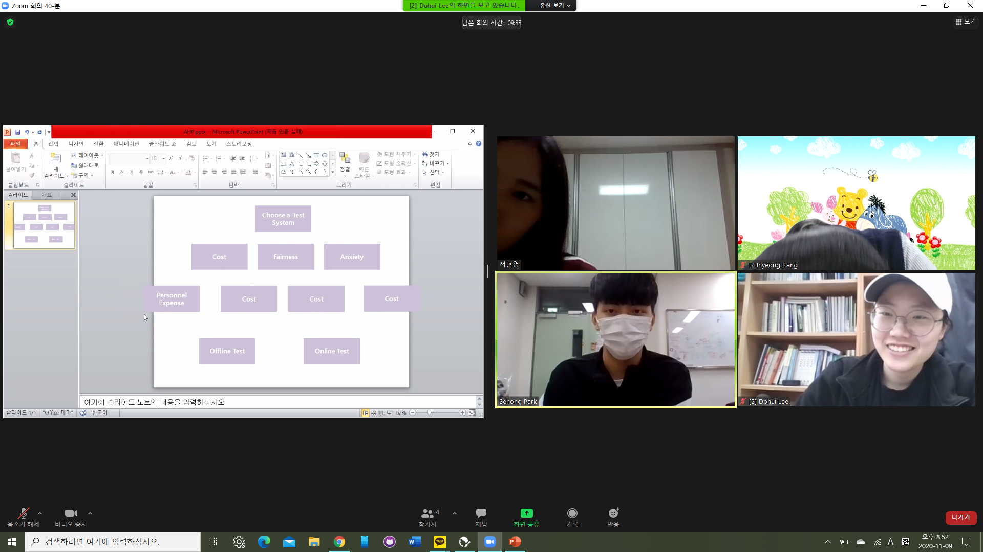

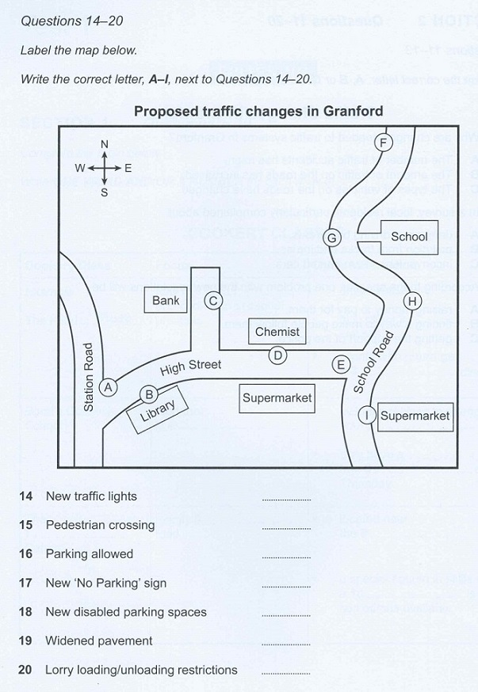
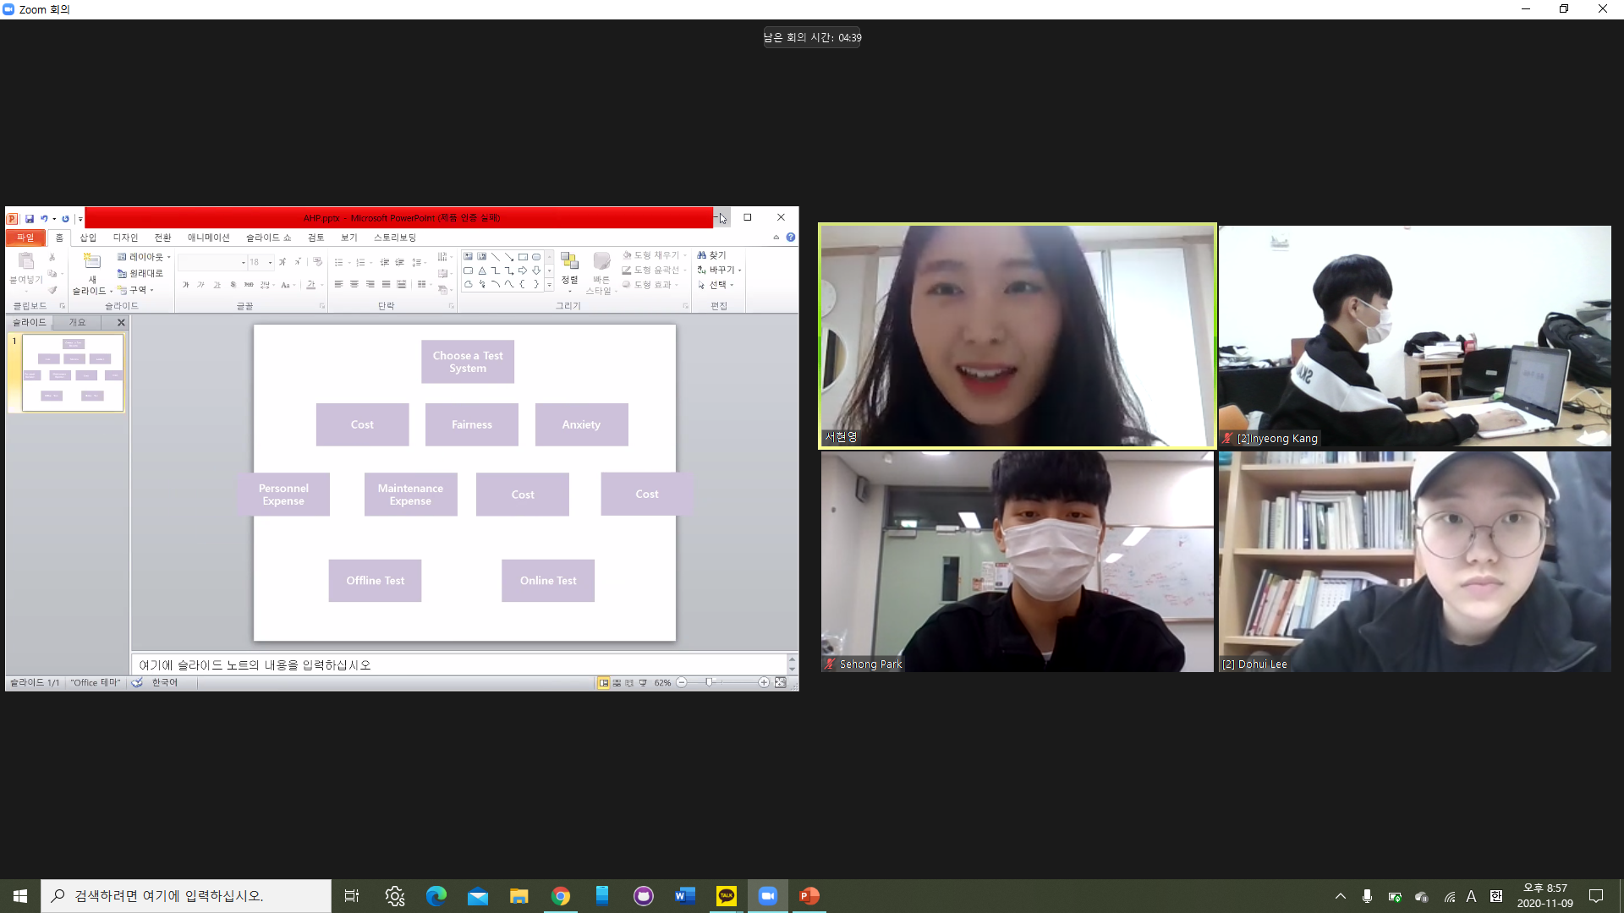
Service Description
01
① New Function : Divided Screen Service
Exam supervisor can see both webcam and computer screen of test-taker.
Computer Screen
Web Cam

Slide 6
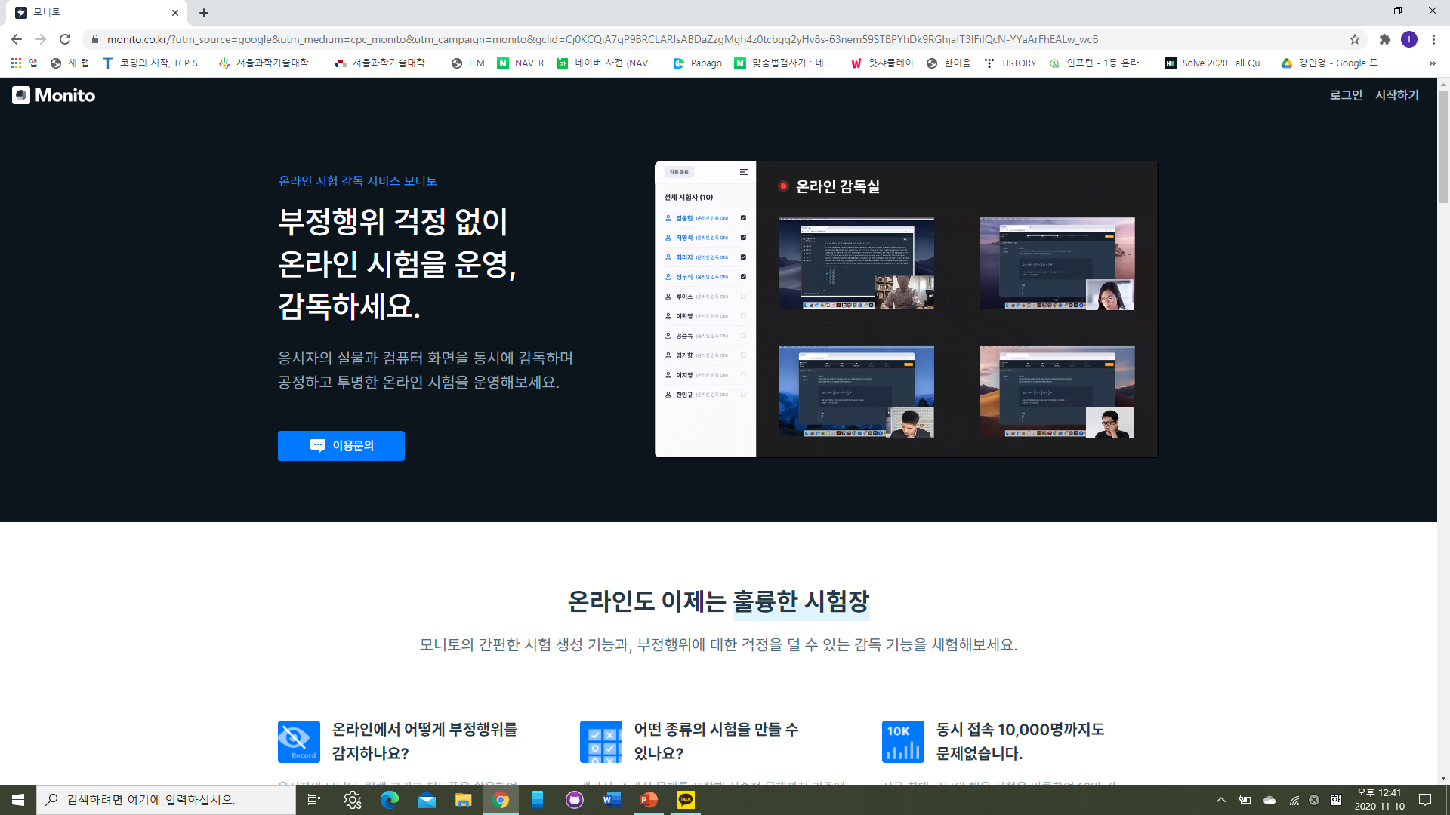

Service Description
01
② New Function : Screen Control Service
Exam supervisor can control the students’ screen by compulsion not to do anything
List of examinee
Web Cams
Exam supervisor
Notes:
. Also, can hand out and collect exam paper at the same time.

Slide 7

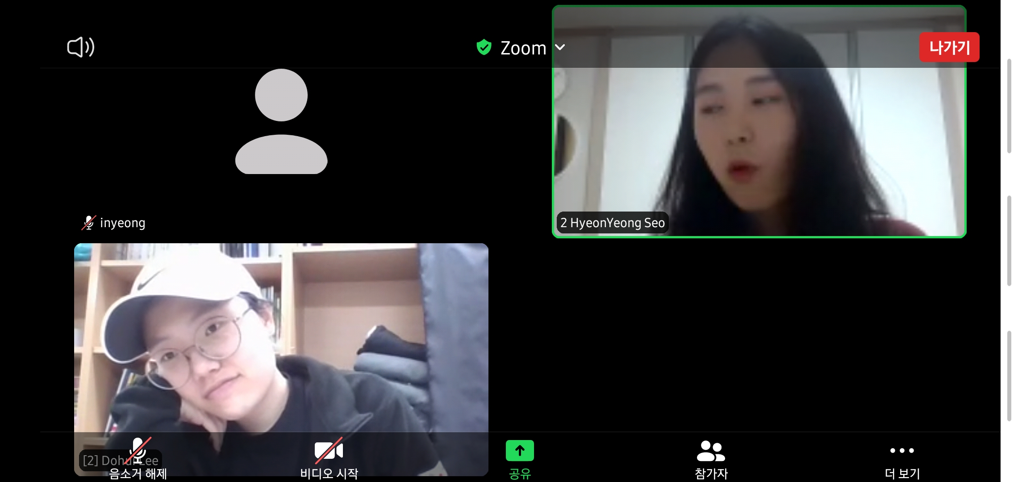

Service Description
01
③ New Function : Paper Scan System
Students can use exercising paper after scanning that paper with zoom application.
Supervisors can check whether the students’ paper is totally empty to prevent cunning.

Slide 8
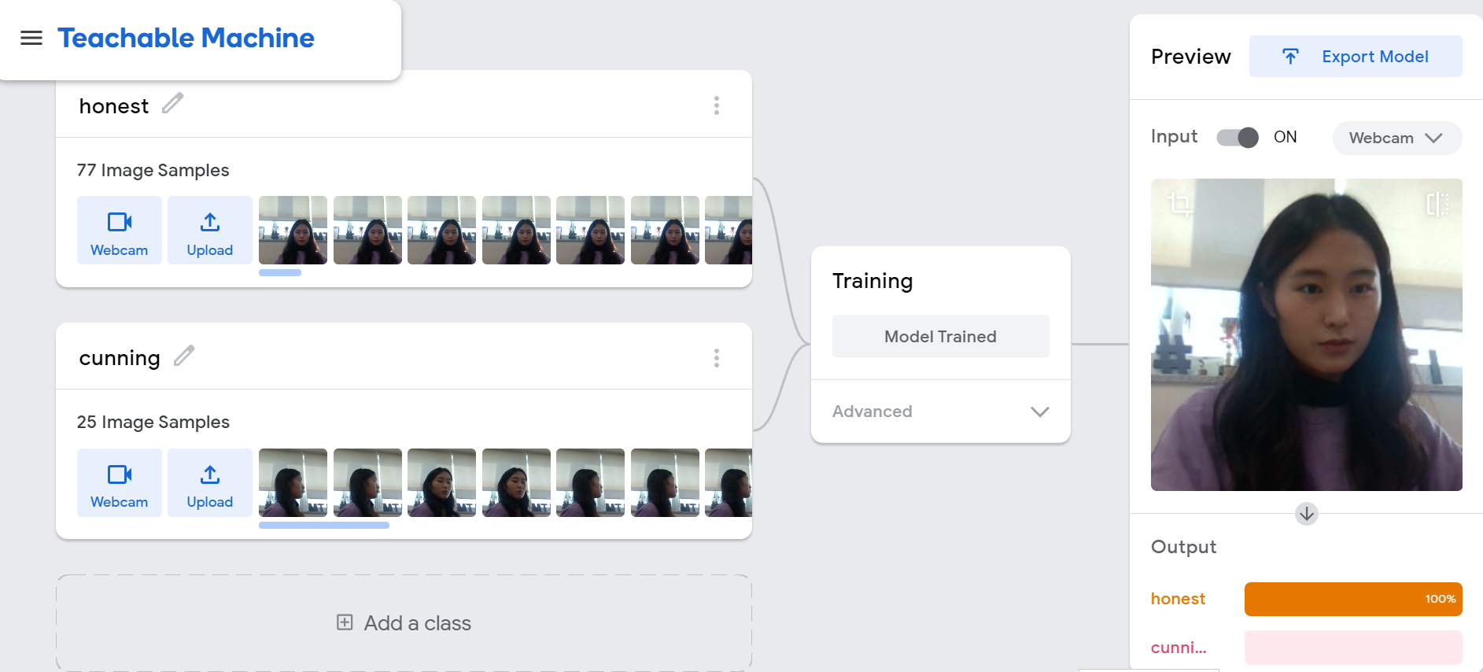
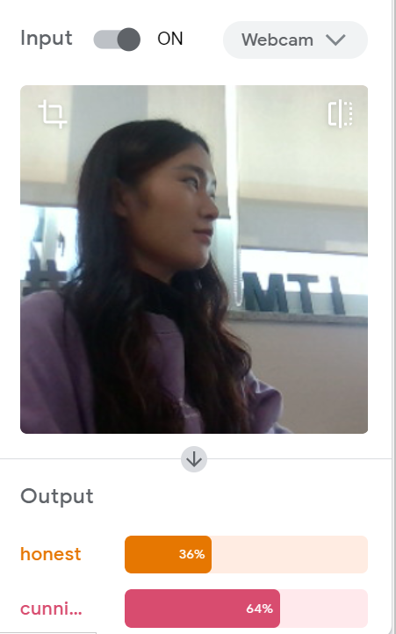
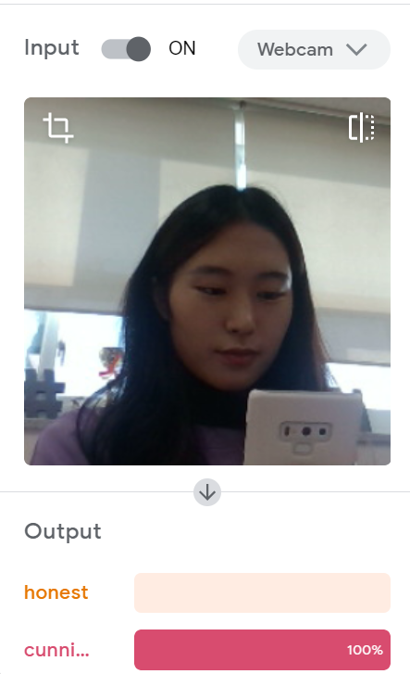

Service Description
01
④ New Function : Motion Detecting System
Normal Attitude
Cheating
Student No.34
Cunning behavior detected!
If a student appears to be cheating, exam supervisor can receive the notice.
Then, the student will be given a penalty.
Cheating Motion Detected Screen

Slide 9
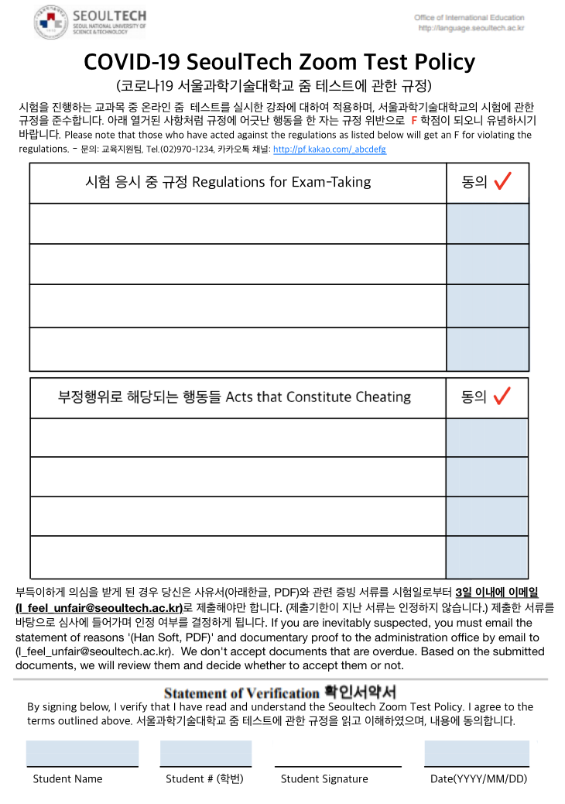
01
Service Description
Private Information Policy
Before taking an exam, students should agree to film the attitude and surrounding environment.

Slide 10
Team’s Project Objectives
02

Slide 11
Team’s Project Objectives
02
1.
Is online exam proctoring system used in universities?
2.
Is online exam proctoring system economically acceptable?
3.
How much should the system be sold?
4.
What is the best choice between offline exam and online with this system on AHP?

Slide 12
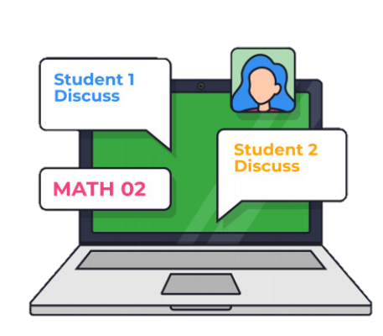


Team’s Project Objectives
02
Scenario
Sample Target = SeoulTech University -> Universities in Seoul
Compare the cost of online and offline exam -> Choose the best option.
Online exam with
“Zoom for Test”
Offline exam
on campus

Slide 13
Environment Analysis
03
- System

Slide 14
Environment Analysis – Market Analysis
03
Offline Exam
Online Exam
Off-line
Limit Place
Less Cheating
Hight Anxiety
On-line
No-Limit Place
More Cheating
Low Anxiety

Slide 15
Environment Analysis – SWOT Analysis
03
 |  | Strength | Weakness
 |  | - Easy to use - Can prevent a virus infection - Zoom already have users | - Exist limitation of technology - Necessary computer or notebook with camera
Opportunity | - Technological innovations and the increasing development of online services - Few alternative services | [ Strength : Opportunity ] - With the fast-growing industry, improve its strong features to better version constantly - Take this system’s position in online test market | [ Weakness : Opportunity ] - Make a better pricing strategy and improve their technological features
Threat | - Customers might switch to another products easily - Reduction of virus spread | [ Strength : Threat ] - Develop better function to maintain and increase Zoom for test’s users - Promote this system about preventing a virus infection | [ Weakness : Threat ] - Put more investment on R&D department to give their customers better service - Support digital devices to students who are financial difficulty
Inner Factor
External Factor

Slide 16
Environment Analysis – Five Forces Analysis
03
Threats of new entrants
Bargaining power of customers
Competitive Rivalry
Bargaining power of suppliers
Threats of substitute

Slide 17
Cost/Benefit Analysis
04

Slide 18
Cost/Benefit Analysis
04
1.
Software Development Cost
2.
Maintenance Cost

Slide 19

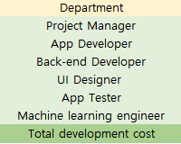
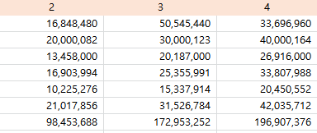
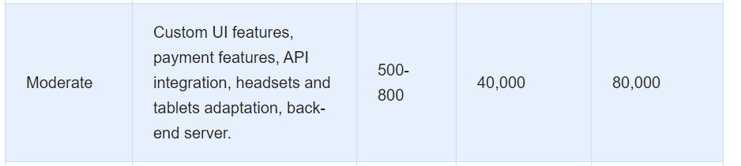
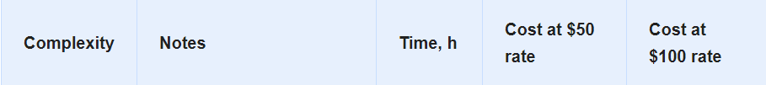
Cost/Benefit Analysis
04
Software Development Cost
Project Manager
App Developer
Back-end Developer
UI Designer
App Tester
Machine learning engineer
Moderate level development => Spend 2-4months
=> 98,453,688 ~ 196,907,376 ₩
www.glassdoor.com

Slide 20
Cost/Benefit Analysis
04
Maintenance Cost
15% of SW development cost for 1 year
=> 59,072,213 ~ 73,840,266 ₩

Slide 21
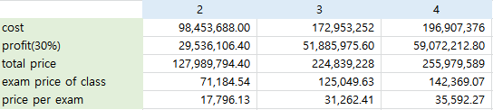
Cost/Benefit Analysis
04
Revenue = 118,216,653 ~ 201,333,163 ₩
In the future,
Revenue from 50 universities in Seoul = 6,399,489,720 ~ 12,798,979,440 ₩

Slide 22

Cost/Benefit Analysis
04
Online Exam
VS
Offline Exam

Slide 23
Cost/Benefit Analysis
04
Online Exam
VS
Offline Exam
1.
+
1.
Zoom
Zoom for Test
Workforce Cost
Cost
2.
Virus Preventing Cost
3.
Disinfection Cost
4 times test for a year
Notes:
줌정기권을 구매한 사람을 대상으로 줌포테스트를 이요할수 있게끔.
두개 비용을 모두 합한게 최종 비용이 된다는 것을 언급해야함
(왜냐하면 우리는 줌 서버와 같은 이미 구축된 시스템을 무료로 사용한다고 가정햇으니까) 줌의 확장판
학교는 1학기 2번 2학기 2번 총 4번의 시험을 치는것으로 가정.

Slide 24
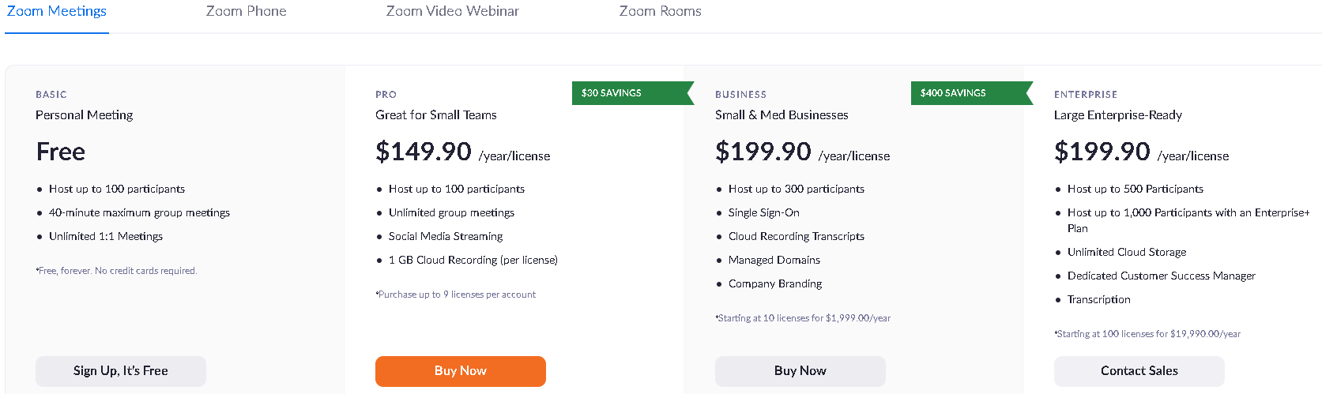
Cost/Benefit Analysis
04
Online Exam
Zoom price : 1,115 ₩(11.9 : exchange rate) * $149.90 * 1798 classes = 300,515,023 ₩
Zoom for Test : development for 2months – 127,989,794 ₩
development for 3months - 224,839,228 ₩
development for 4months – 255,979,589 ₩
Total Price :
Zoom price + Zoom for Test price for 4 time(2mid+2fin) = about 428,504,817 ~ 556,494,612 ₩
Notes:
먼저, 학교가 온라인 시험 도입한다고 가정하자.
그때의 코스트
Zoom for test 코스트와 줌 코스트 라잌 디스
줌+줌포테스트 최종가격이 이렇게 된다. 약 278,069.8 ₩

Slide 25
Cost/Benefit Analysis
04
Online Exam
Intangible Cost
Unfairness
Concentration
Differences of digital devices
Resistance to change …
There are many potential effects.
But, we conduct the cost/benefits analysis without them and just list them.

Slide 26
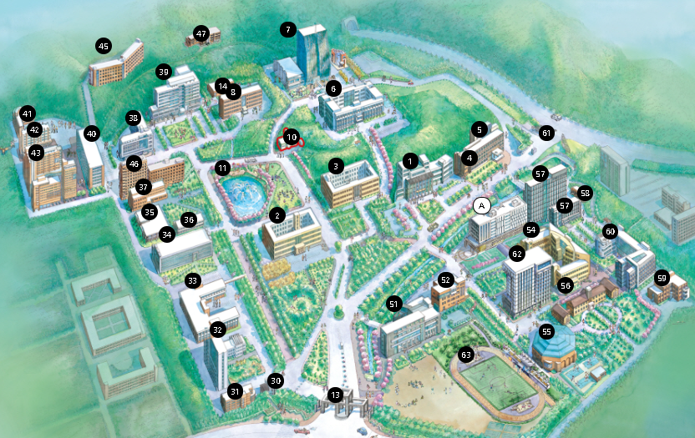
Cost/Benefit Analysis
04
Offline Exam
Workforce cost
 | Work Scholarship (monthly salary) | Students | Month
Cost | 9,000 * 52 hours per month = 468,000 | 468,000 * 150 people = 70,200,000 | 70,200,000 * 8 months = 561,600,000
=> 561,600,000 ₩
35 major buildings requiring body temperature measurement
Notes:
이제부턴 학교가 오프라ㅣㄴ 도입시 드는 비용이다.
체온측정을 위해 쓰인 인력비는 이정도. (방학뺀 기간 8개월)
Workers at Seoultech disaster and safety management headquarters -> 130 current students
서울과학기술대학교 재난안전관리본부 근로장학생 -> 현 130명
Between 9 a.m. and 6 p.m., there are cases where working students leave their seats for temperature measurements -> 20 supplementation.
코로나 체온 측정 검사를 위한 근로학생이 비워져 있는 경우가 있음 -> 20명 보충
If all students do not come to school, self-measurement is enough through the building pass, but the school selects a working scholarship student because the students come to the school to take the test.
만약 모든 학생들이 학교에 오지 않는다면 건물 출입증을 통해서 자가 측정만으로도 충분하지만, 시험을 보기 위해 학교에 학생들이 오기 때문에 학교측은 근로장학생을 뽑음

Slide 27
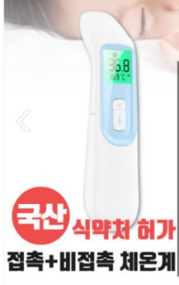
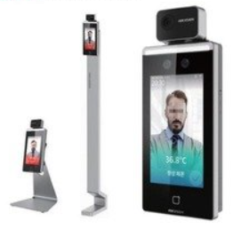
Cost/Benefit Analysis
04
Offline Exam
Virus Preventing Cost
Thermometer
Facial recognition thermometer
 | Thermometer | Number | Total Cost (1 year)
Cost | 75,000 Won | 75,000 * 35 buildings = 2,625,000 | 2,625,000 Won
 | Thermometer | Number | Total Cost (1 year)
Cost | 2,000,000 Won | 2,000,000 * 35 buildings = 70,000,000 | 70,000,000 Won + α
=> 2,625,000 ₩
=> 70,000,000 ₩
Notes:
인력비 뿐만 아니라 방역을위한 여러
체온측정기 구입에 필요한 돈은 이정도.
L0 (error) often appears in the Frontier building -> Corona's temperature test is not performed properly due to the inability to accurately measure body temperature.
After the corona virus, only the thermometer was used, and when more and more people were infected, the body temperature meter was purchased.
현재 프론티어관에 있는 체온측정기는 L0(오류)가 뜨는 경우가 많음 -> 정확한 체온 측정 불가로 코로나 체온 검사가 제대로 이루어지지 않음) (코로나 바이러스가 생긴 후 체온계만 사용하다가 점점 감염자가 많이 발생하자 체온측정기를 구매함

Slide 28


Cost/Benefit Analysis
04
Offline Exam
Virus Preventing Cost
Hand sanitizer
Disinfection tissue
 | Hand sanitizer | Use (per month) | Building | Total Cost (1 year)
Cost | 7,000 won | 7,000 * 40 bottles = 280,000 | 280,000 * 35 buildings * 8 months = 9,800,000 * 8 = 78,400,000 | 78,400,000 Won
 | Disinfection tissue | Number | Total Cost (1 year)
Cost | 800,000 Won | 800,000 * 35 buildings = 28,000,000 | 28,000,000 Won + α
=> 78,400,000 ₩
=> 28,000,000 ₩
Notes:
Sanitizer 구입을 위한 비용은 다음과 같다.

Slide 29
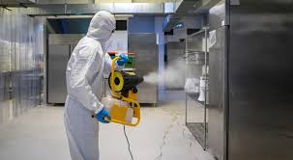
Cost/Benefit Analysis
04
Offline Exam
Disinfection Cost
※ Disinfection cost: The average classroom cost is 60,000 won per 3.3m^2
 | Disinfection | Number | Test | Total Cost (1 year)
Cost | 3,000,000 Won | 3,000,000 * 15 buildings = 45,000,000 | 45,000,000 * 4times = 180,000,000 | 180,000,000Won + α
=> 180,000,000 ₩
Notes:
방역을 위한 코스트는 다음과 같다.

Slide 30
Cost/Benefit Analysis
04
Offline Exam
Intangible Cost
Time to spend commuting
Anxiety about virus
Traffic expense…
There are many potential effects.
But, we conduct the cost/benefits analysis without them and just list them.

Slide 31

Cost/Benefit Analysis
04
Online Exam
VS
Offline Exam
1.
+
1.
Zoom
Zoom for Test
Workforce Cost
Cost
2.
Preventing Cost
3.
Disinfection Cost
<
2months: 428,504,817₩
3months : 525,354,251 ₩
4months: 556,494,612₩
920,625,000 ₩
Notes:
Based on the previous slides we can find that offline exam take much more expensive cost.

Slide 32

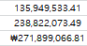
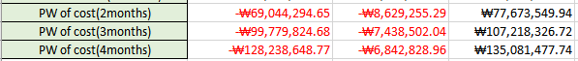
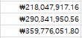
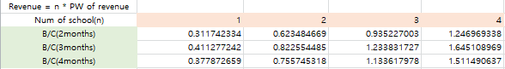
Cost/Benefit Analysis
04
B/C Ratio
# of school = 1
# of school = 2
If more than 3~4 universities use our system,
B/C ratio exceeds 1~! -> Acceptable.

Slide 33

AHP Analysis
05

Slide 34
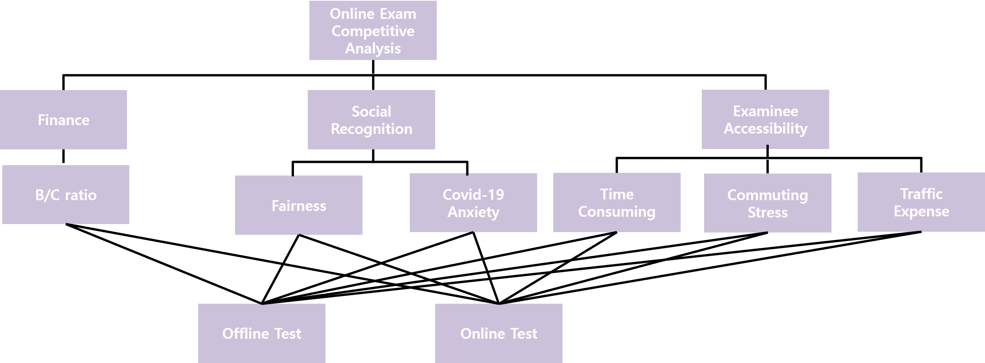
AHP Analysis
05
Level 1
Level 2
Level 3
Notes:
온라인 이그잼 경쟁성 분석을 위해서 Ahp 분석을 햇다.
필요한 criteria들은 크게 세개 f, s, e
각 세부 기준들은 이것들
Alternative - > off, on

Slide 35
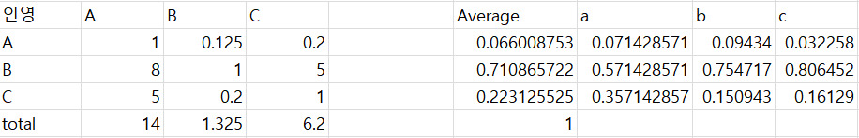
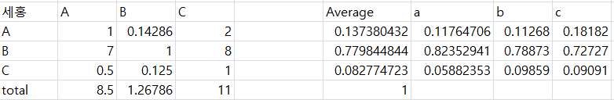
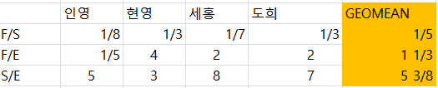
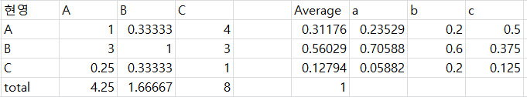
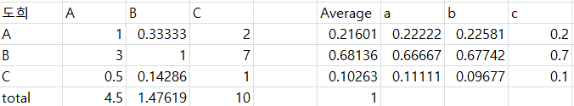
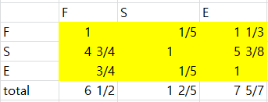
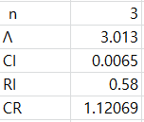
AHP Analysis
05
Level1
Because CR < 10% , it is consistent.
Notes:
레벨 1 ahp 분석 결과

Slide 36
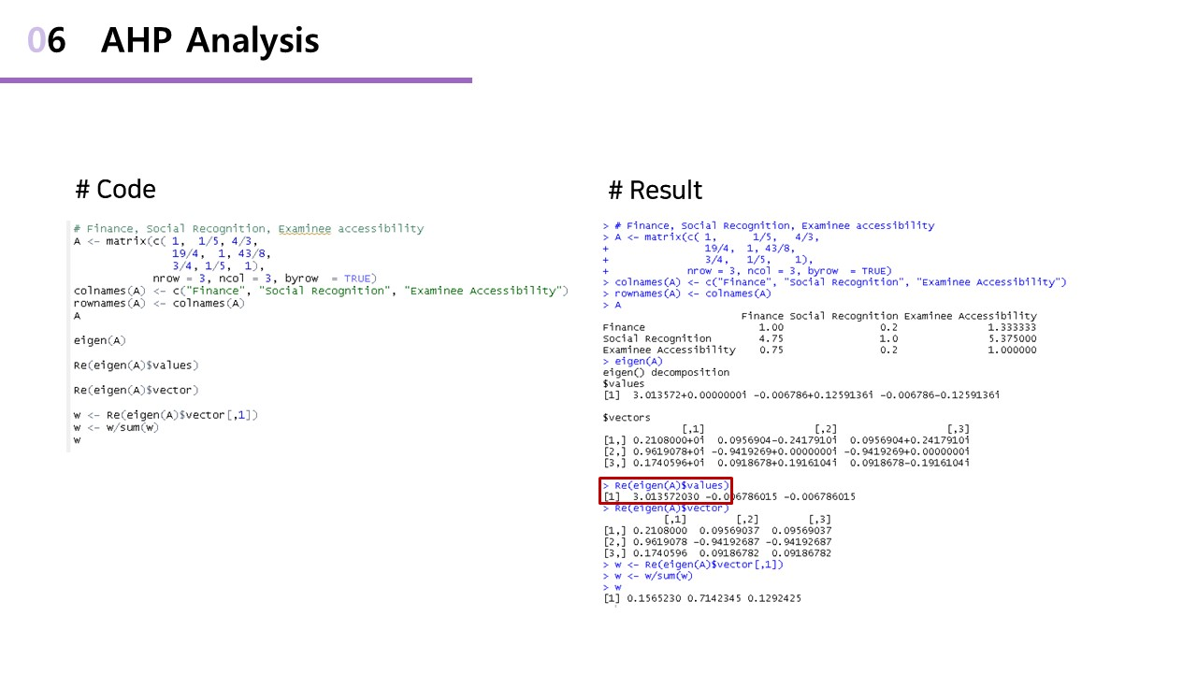

Notes:
R 이용해서 아이겐 벨류를 구했다.

Slide 37
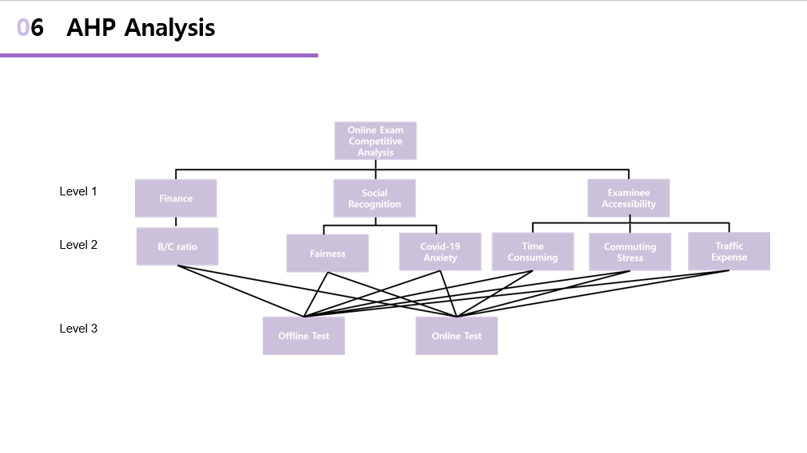

Slide 38
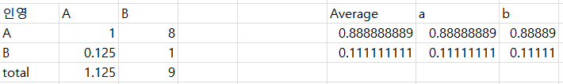
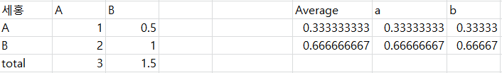
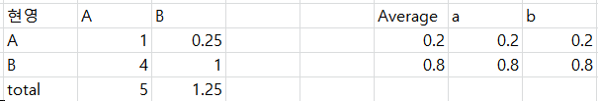
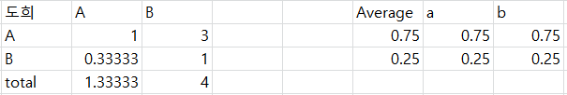
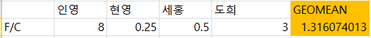
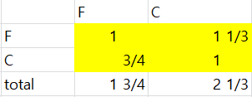
AHP Analysis
06
Level 2 – social recognition
Notes:
social recognition ahp 분석결과다.

Slide 40
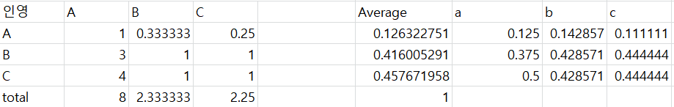
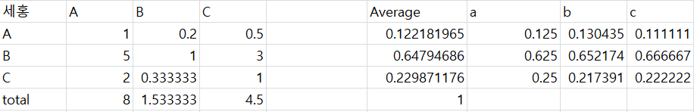
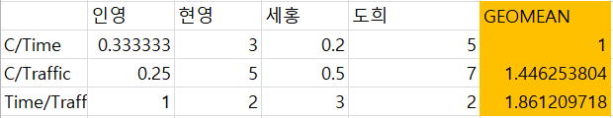
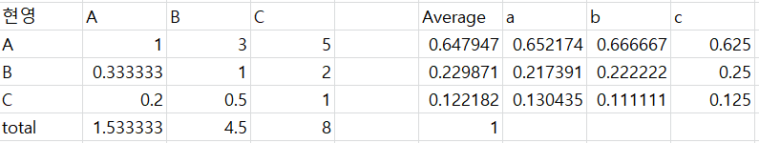
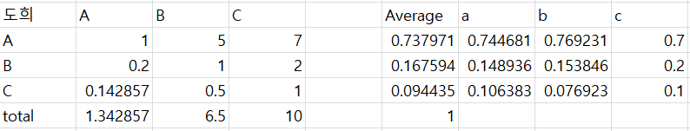
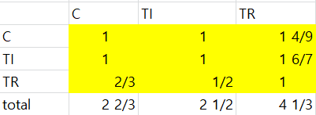
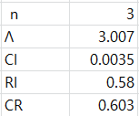
AHP Analysis
06
Level 2 – Examinee accessibility
Because CR < 10% , it is consistent.

Slide 42
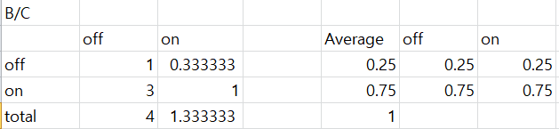
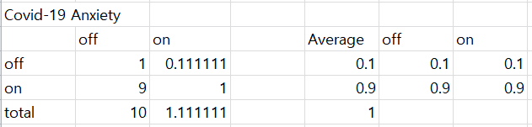
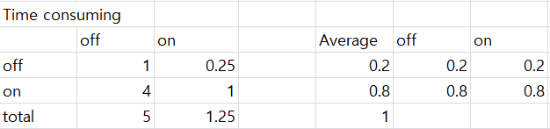



AHP Analysis
06
Level 3

Slide 43




AHP Analysis
06
Final Result
Level 2
Level 3
Therefore, “Zoom for Test” online exam proctoring system is reasonable.

Slide 44
Conclusion
06

Slide 45



Slide 46
Thank You

